Slide 1


RESPONSIVE TEACHING GUIDANCE BOOKLET
V1.1 Sept 2023

Slide 2
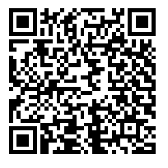
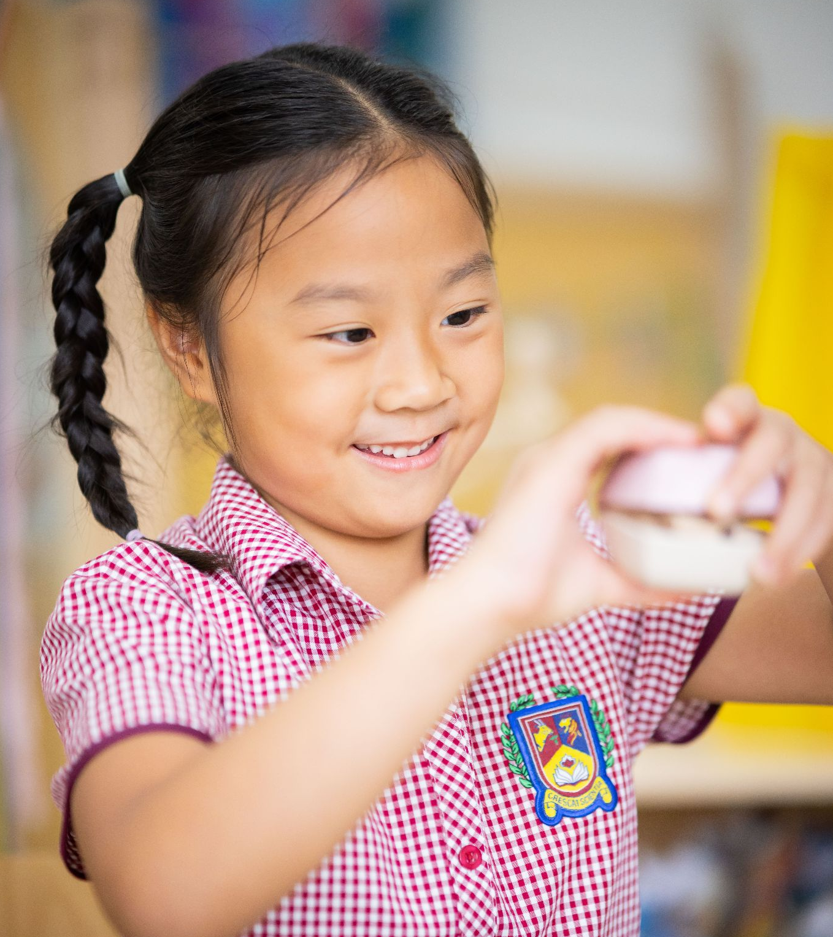
INTRODUCTION
Scan the QR code for editable slides
This guidance handbook is designed to support teachers with ways of providing high-quality, actionable and meaningful feedback in various forms.
“When providing feedback, it should be more work for the pupil and not for you as the teacher. Repetitive comments repeated across a whole set of books should be a ‘marking’ approach from the past. It wastes teachers time and does not have the desired impact on feeding pupils forward.”
- Michael Chiles
Notes:
2 column text with photo template

Slide 3
Contents page
Feedback policy
How does our assessment feedback
Whole Class feedback
Modelling
Self-assessment
Questioning
How to make it responsive
Notes:
2 column text with photo template

Slide 4

The simplest prescription for improving education must be dollops of feedback.
- John Hattie

Slide 5
FEED ‘UP’ - Where am I going?
FEED ‘BACK’ - How am I going?
FEED ‘FORWARD’ - Where am I going?

Slide 6

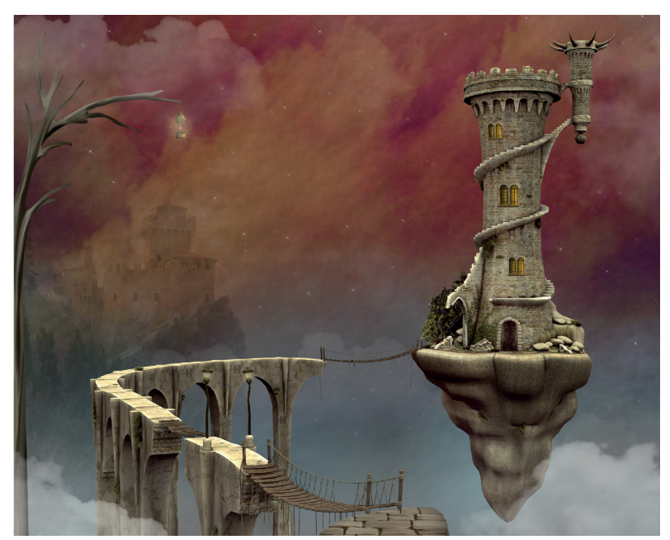
COMPARATIVE JUDGEMENT
Comparative judgement is a process where judges compare two responses and decide which is better. Research has shown the process to be as reliable as double marking, but much quicker. - No More Marking website
The process of comparative judgement typically involves multiple judges from different schools around the world. They are presented with pairs of writing samples. They are then asked to determine which piece of writing is of higher quality or meets specific criteria better. This comparison continues for multiple pairs of writing until a ranking is established.
Notes:
2 column text with photo template

Slide 7
COMPARATIVE JUDGEMENT
To be responsive
Use the data to inform English planning. Is there a common theme amongst cohorts?
Notes:
2 column text with photo template

Slide 8


COMPLETE MATHS
Complete Maths is where we will find our Maths objectives. It is a structured scheme of work that includes detailed breakdown of topics, lesson plans and assessments aligned with the curriculum.
Notes:
2 column text with photo template

Slide 9

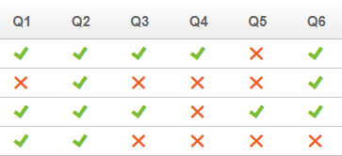
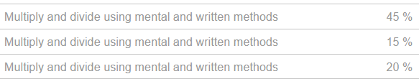
MATHS.CO.UK
Maths.co.uk is an online formative assessment tool for Y1-6. Teachers can set assessments for every maths objective covered in the national curriculum. Each assessment can be tailored to the students needs and offers a variety of models and representations covered by our calculation policy. Data from each assessment provides detailed analysis and gaps analysis to inform planning and next steps.
Use the data to inform classroom environments and interventions following the unit of learning or use it to identify gaps in learning before teaching a particular unit.
Notes:
2 column text with photo template

Slide 10


READ WRITE INC - PHONICS
Designed to teach children how to read, write, and spell words. It was developed by Ruth Miskin. Aims to develop fluent readers and confident writers by teaching the essential skills of phonics: Synthetic phonics, speed sounds, blending and segmenting, sight words, text comprehension and assessment and progress monitoring.
Notes:
2 column text with photo template

Slide 11
Effective | Ineffective
A specific, granular target that is focused on the next step. “Remember, an excellent piece of suspense writing should include an empty word...” | Next steps are vague and unhelpful. “Add more detail to to your explanation’ ‘Write more about this point’
The feedback will focus on the elements of the work that demonstrate understanding with constructive comments to direct improvement. | The feedback focuses mainly on where the pupil made incorrect responses.
Creates an opportunity for self/peer assessment to encourage pupils to take responsibility. | The feedback provided is too reliant on extrinsic rewards such as stickers and house points.

Slide 12
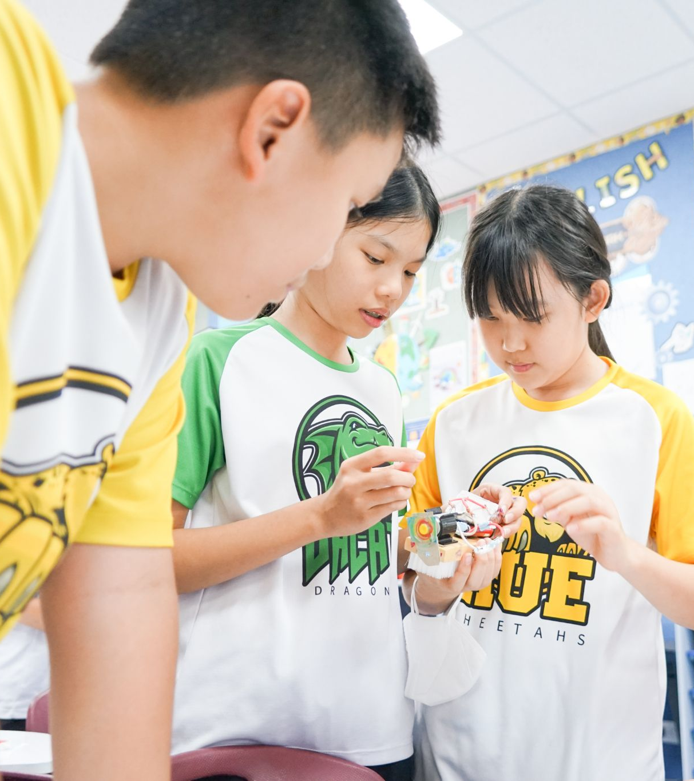
FOR FEEDBACK TO BE TRULY EFFECTIVE, CHILDREN NEED TO BE ACTIVELY INVOLVED IN THE PROCESS
If you raise the “BAR”, the children will grow to meet it.
B- belief: when a student feels unstoppable, there’s no limit to what they can learn.
A - action: without action, nothing can be done.
R- result: outcome of a strong belief system backed by consistent action.
Notes:
2 column text with photo template

Slide 13
Immediate feedback | Delayed feedback
It is effective to provide instant mistake correction during task performance; this may lead to quicker accomplishment. | It is effective to provide delayed mistake correction during the processing of a task when it requires a longer duration to accomplish the task.
Its effects are likely to be more powerful at the task level. | Its effects are likely to be more powerful at the process level.
It is useful for attaining easy learning outcomes because it involves a shorter degree of processing about the task. | It is useful for attaining difficult learning outcomes because it involves a great degree of processing about the task.

Slide 14
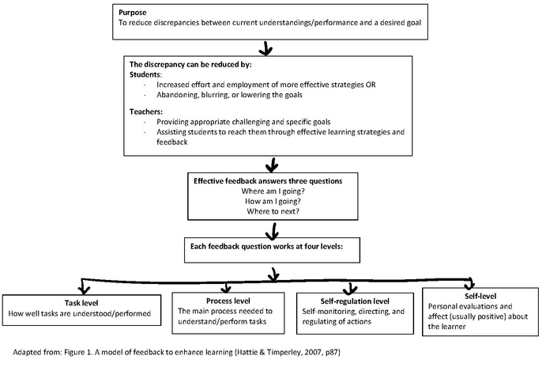
Notes:
2 column text with photo template

Slide 15
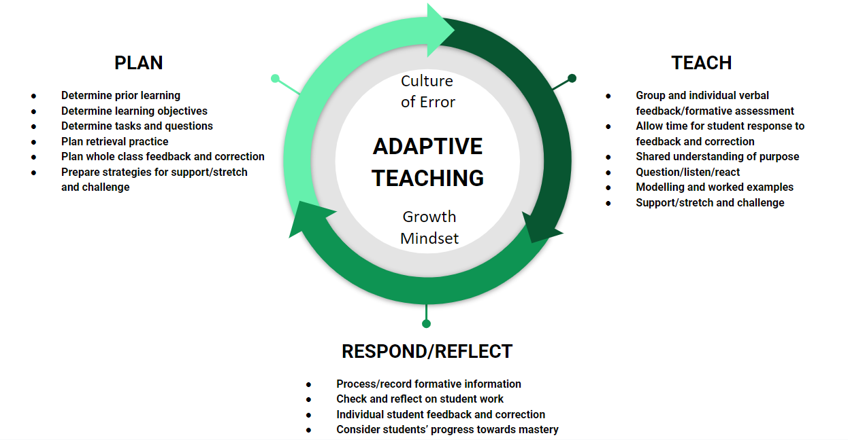

Slide 16
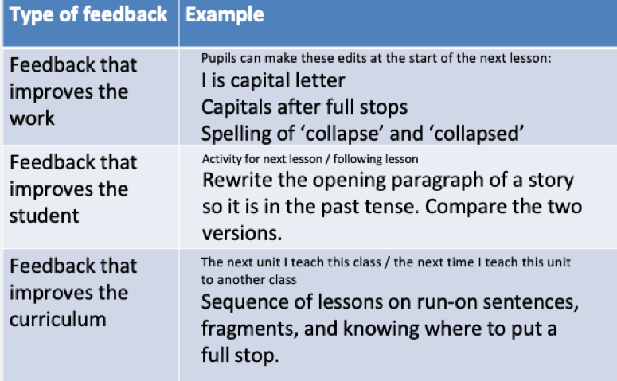

Notes:
2 column text with photo template

Slide 17
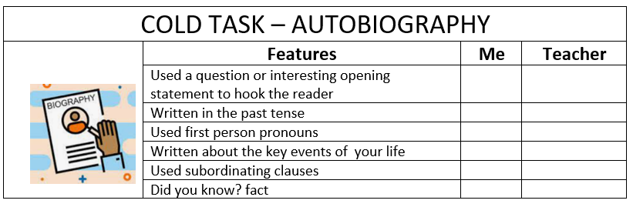
T4W - COLD TASKS
Cold Tasks
The cold task is an initial writing activity that is completed at the beginning of a unit or topic. It serves as an assessment tool to gauge students' prior knowledge, skills, and understanding of the writing genre or topic. The purpose of the cold task is to establish a baseline and identify areas for improvement and focus during the teaching and learning process.
The cold task should be completed to inform the ‘model text’ in the T4W approach. It doesn’t always have to be completed for every unit. It should inform your planning.
Notes:
2 column text with photo template

Slide 18
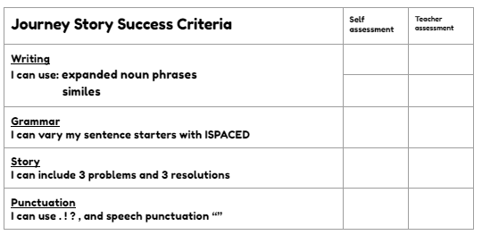
T4W - HOT TASKS
Hot Tasks
The hot task is the final writing task conducted at the end of the unit or topic. It is similar to the cold task, but this time, students demonstrate their improved understanding and skills in the writing genre or topic. The hot task allows students to showcase their progress and achievements, and it serves as a form of summative assessment to assess their growth.
This could be done at the end of the unit, or it could be something that you come back to after a few weeks. The ‘success criteria’ should be what you have learned from the model text. Children don’t have to complete a full task.
Notes:
2 column text with photo template

Slide 19
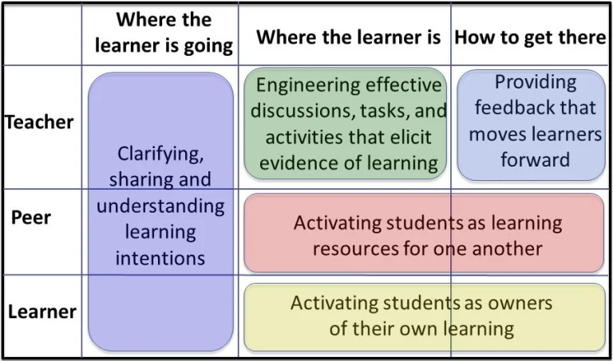
Underpinning effective teaching is the need for teachers to be responsive; working to react to the minute-by-minute assessment information gathered and working to consolidate and expand children’s knowledge systematically.
Notes:
2 column text with photo template

Slide 20
Pull-out quote template.
“The quality of feedback, however given, will be seen in how a pupil can tackle subsequent work.”
- Michael Chiles
Notes:
Pull-out quote template

Slide 21

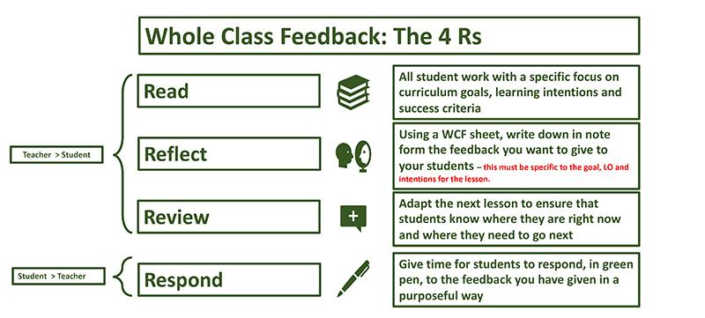
Whole Class Feedback
Whole class feedback is an approach to assessment and feedback. Rather than providing individual feedback on every student's work, teachers provide feedback to the whole class based on common strengths and weaknesses that they have identified in the work.
This approach has a number of benefits, including saving teachers time, providing more targeted feedback to students, and promoting a growth mindset in the classroom.
Notes:
2 column text with photo template

Slide 22

Whole Class Feedback - the benefits
Allows time for children to edit and improve their work.
Corrects misconceptions
Helps improve the learner, not just the work
Saves time rather than writing comments in individual books
Allows children to take ownership in their learning
Doesn't have to be the same ‘proforma’
Notes:
2 column text with photo template

Slide 23
Whole Class Feedback - more benefits!
Time-saving: Whole class feedback allows teachers to provide targeted feedback to the entire class in a more efficient way, freeing up time for other important tasks.
More targeted feedback: By identifying common strengths and weaknesses in the work, whole class feedback can provide more targeted feedback to students. Teachers can focus on specific areas that students need to improve upon, helping them to make more progress in their learning.
Promotes a growth mindset: By focusing on areas for improvement rather than just pointing out mistakes, whole class feedback promotes a growth mindset in the classroom. Students learn that they can always improve and that mistakes are opportunities to learn.
Increases student engagement: Whole class feedback can be more engaging for students than individual feedback, as it allows them to see how their work compares to that of their peers. It can also encourage students to participate in discussions and peer assessment activities.
Encourages self-reflection: Whole class feedback can encourage students to reflect on their own work and identify areas where they need to improve. By providing feedback to the whole class, teachers can create a more open and collaborative learning environment where students are encouraged to take ownership of their own learning.
Supports differentiation: Whole class feedback can be used to differentiate instruction by identifying areas where some students need more support and others need more challenge. This can help teachers to provide more targeted instruction to different groups of students based on their needs.
Notes:
2 column text with photo template

Slide 24
Whole Class Feedback - When to use!
After completing a group project: Whole class feedback can be a more efficient way to provide targeted feedback to the group as a whole, and to identify areas where individual students may need additional support.
After completing a test or assessment: Rather than ‘marking’ every student's test individually, teachers can use whole class feedback to provide targeted feedback to the class as a whole. This can help students to understand common areas of strength and weakness, and to identify areas where they need to focus their efforts.
When introducing a new topic or concept: This can help teachers to adjust their instruction and provide more targeted support to students as needed.
During peer assessment activities: When students are assessing each other's work, whole class feedback can be used to provide feedback to the class as a whole.
After completing a writing task: This allows teachers to identify common areas where students may need more support, such as sentence structure or vocabulary. Teachers can then provide targeted feedback to the class as a whole, and work with individual students who may need additional support.
Notes:
2 column text with photo template

Slide 25
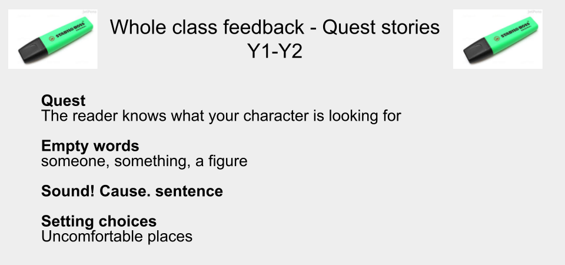
Whole Class Feedback - Y2 example
Notes:
2 column text with photo template

Slide 26
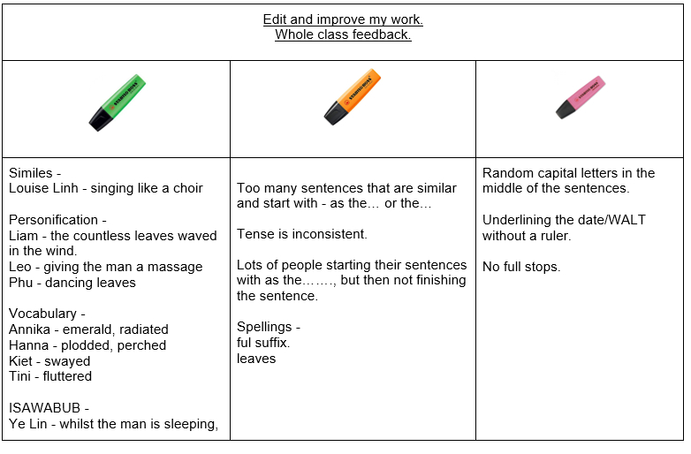
Whole Class Feedback - Y3 example
Notes:
2 column text with photo template

Slide 27
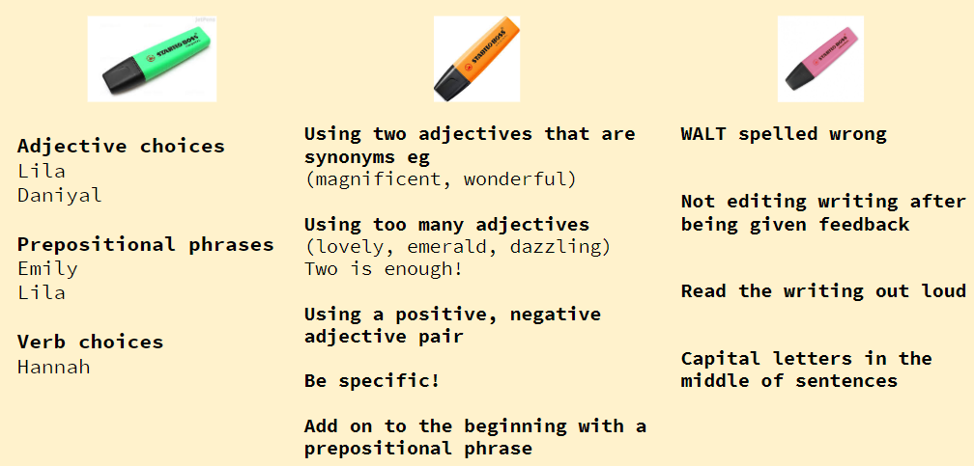
Whole Class Feedback - Y5 example
Notes:
2 column text with photo template

Slide 28
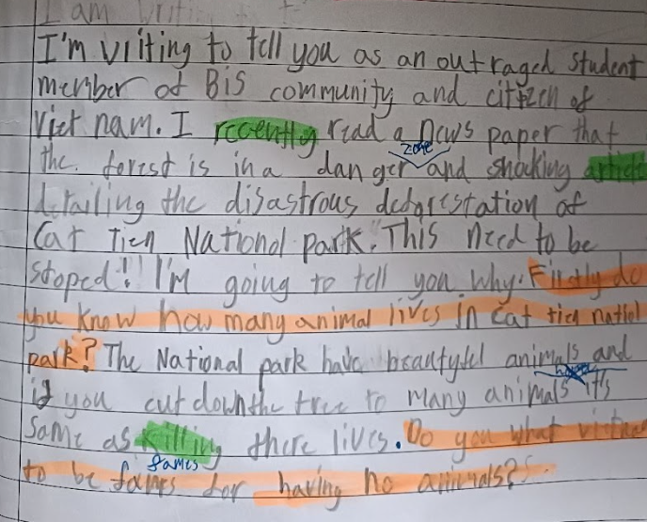
Whole Class Feedback - how it might look
Teacher to identify parts of the success criteria which were -
Green - completed well. Include student’s names for an extra boost. If they can’t find it, they should add it using a blue editing pen.
Orange - things that could have been done better/improved. Have been taught
Pink - non negotiables. Capital letters/full stops. Things you would EXPECT the children to do.
Children edit in blue pen 🙂
Notes:
2 column text with photo template

Slide 29
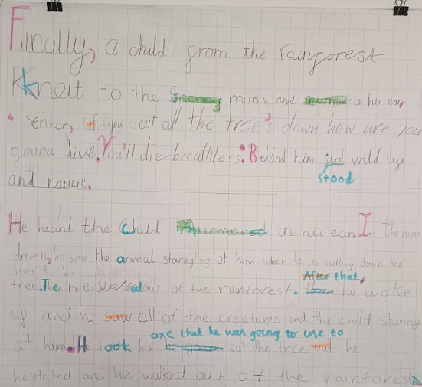


Whole Class Feedback - model together
Notes:
2 column text with photo template

Slide 30
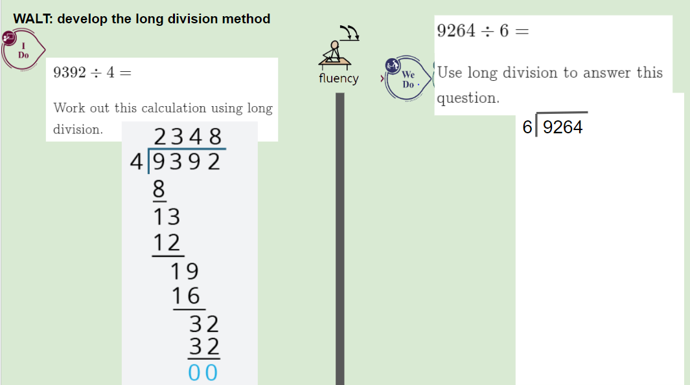
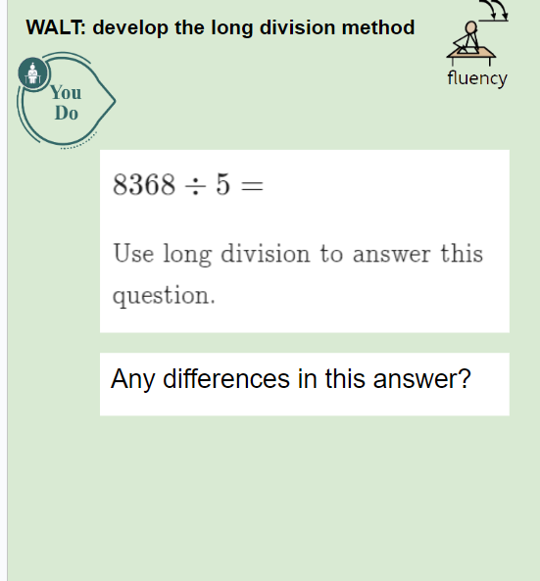
Whole Class Feedback - model together
Notes:
2 column text with photo template

Slide 31
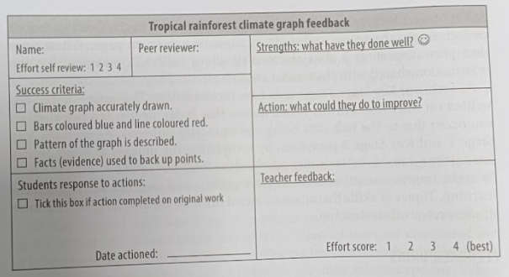
Whole Class Feedback - IPC
Notes:
2 column text with photo template

Slide 32
Pull-out quote template.
“The first fundamental principle of effective classroom feedback is that the feedback should be more work for the recipient than the donor.”
- Dylan Wiliam
Notes:
Pull-out quote template

Slide 33

Modelling
Modelling as a form of whole class feedback is an effective strategy that involves the teacher demonstrating a desired skill or behaviour to the entire class.
It serves as a powerful tool for providing explicit guidance and showcasing work, allowing students to observe and internalise the expected standards and expectations.
By modelling, teachers can provide a clear and concrete example of what success looks like, while also addressing common misconceptions and errors. This approach creates a supportive learning environment where students can actively engage in the learning process, learn from their peers, and develop a deeper understanding of the subject matter.
Notes:
2 column text with photo template

Slide 34
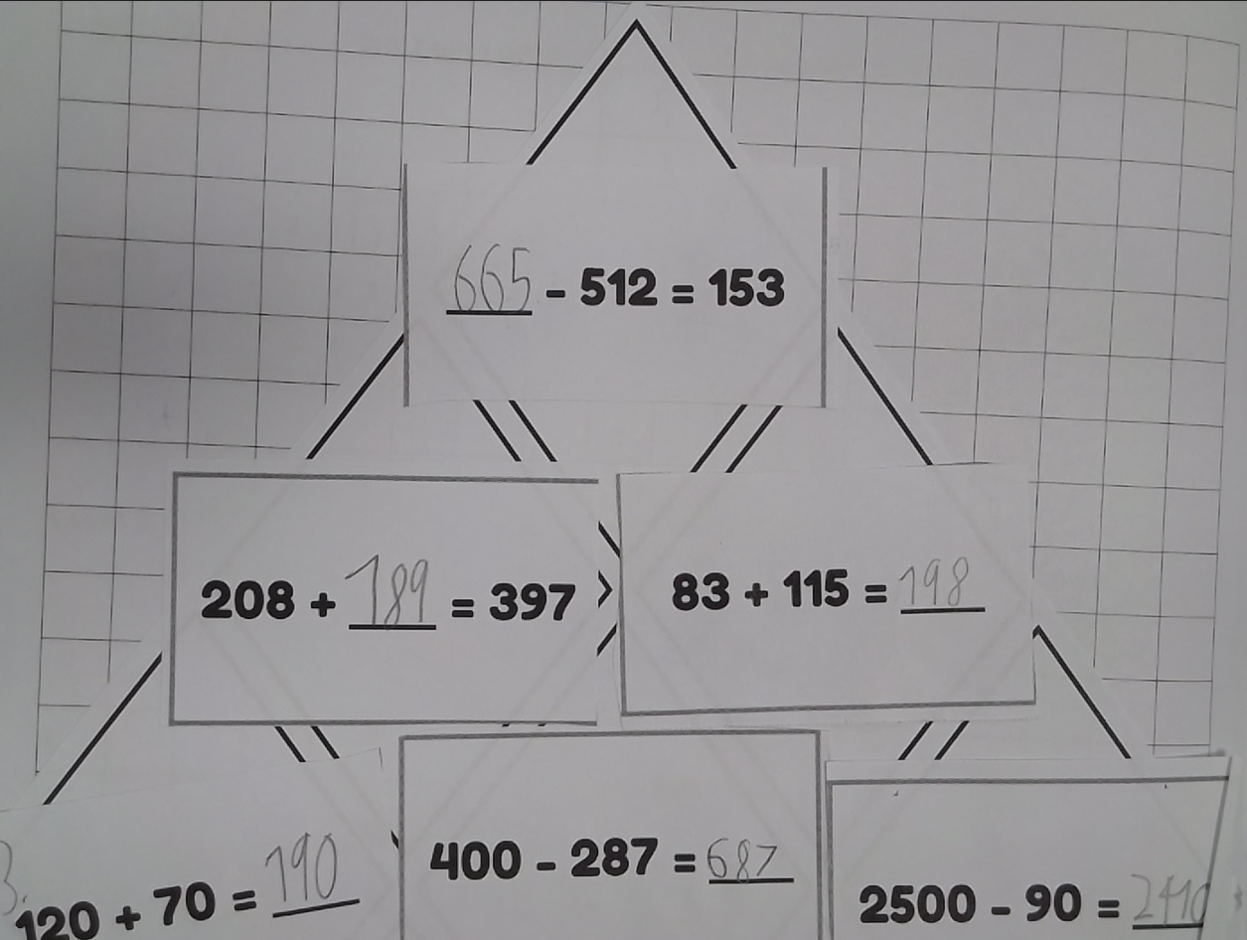
Modelling - Visualiser
Identify what a child has done well - “I really like how...has…”
Model asking yourself questions - “I wonder why…. Has placed 665-512=153 as the most difficult one. Can you please explain?” - “Does anyone have that question somewhere else?”
Address common misconceptions or errors and then get the children to edit their own work during the lesson.
Teachers or children can annotate live in the book or on the whiteboard - children are then given time to edit.
Helps to train children to self-assess and peer-assess - “Find an example of this in your and your partner’s book and underline it in green” “If you don’t have an example of this in your book, then you could try and add one”
Notes:
2 column text with photo template

Slide 35

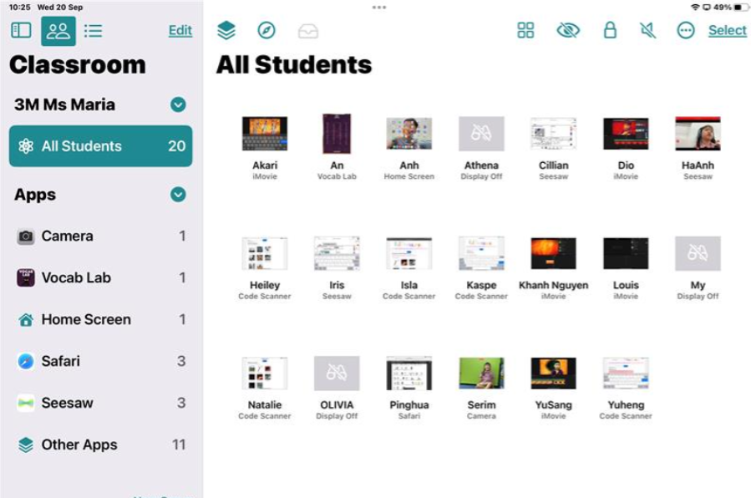
Modelling - Apple Classroom
Assign and Distribute Materials: Teachers can use Apple Classroom to assign and distribute digital materials to students. This could include instructional documents, templates, or examples of the work you want the children to model.
Screen Sharing: Teachers can use the screen sharing feature to display their own work or exemplary work from other students. This allows the whole class to view and discuss the work, facilitating a discussion on what makes it effective or what improvements can be made.
Demonstrate the Process: You can use screen sharing to demonstrate the process of completing a task or project. For example, if you want students to create a multimedia presentation, you can show them how to use the presentation software and provide tips and tricks along the way.
Notes:
2 column text with photo template

Slide 36
Modelling & Feedback - Apple Classroom
4. Provide Feedback in Real-Time: Teachers can use Apple Classroom to monitor students' progress and provide feedback in real-time. This can be especially helpful when students are working on modeling tasks, as you can offer guidance and suggestions as they work.
5. Peer Review: You can use Apple Classroom to facilitate peer review sessions. Students can share their work with each other and provide constructive feedback. This helps them learn from each other and improve their own work.
6. Collect and Assess Work: Once students have completed their modeling tasks, you can use Apple Classroom to collect their work digitally. This makes it easier to assess and provide feedback, and it allows for a more organized way of keeping track of students' progress.
7. Collaborative Projects: Encourage collaboration by using Apple Classroom to create groups or pairs of students working on modeling projects together. They can then share their progress and collaborate in real-time.
8. Archive and Share Exemplary Work: After students have completed their modeling tasks, you can archive exemplary work to showcase to future classes. This can serve as a reference point for new students and help set expectations for the quality of work.
Notes:
2 column text with photo template

Slide 37
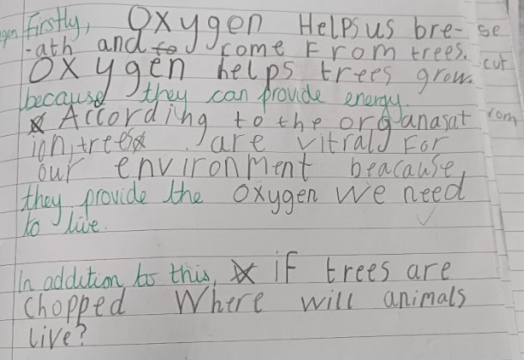
Modelling - Tandem Writing
A collaborative writing activity where teacher/TA/children take turns writing or contributing to a piece of written work. Tandem writing provides an interactive and cooperative approach to writing that enhances students' writing abilities, promotes communication and collaboration, and cultivates a sense of ownership and pride in the written work.
The teacher and the child form a ‘partnership’ for the writing activity. This one-on-one interaction allows the teacher to provide individualised support and guidance tailored to the child's needs and abilities.
The teacher and the child take turns writing or contributing to the written piece. They might alternate after a sentence, paragraph, or designated time interval.
The teacher models writing skills and strategies, providing demonstrations and explanations as they write together. The child actively participates and contributes their ideas, thoughts, and sentences.
Notes:
2 column text with photo template

Slide 38
Modelling - I do, You do, We do
The "I Do, You Do" approach involves a gradual shift of responsibility from the teacher to the students, promoting active engagement and independent learning.
"I Do" Stage:
Teacher-led Instruction: In this stage, the teacher takes the lead and provides explicit instruction or demonstration of the concept or skill. The teacher models and explains the steps, thought processes, or strategies involved.
Thinking Aloud: The teacher verbalises their thinking, reasoning, and problem-solving steps, making their thought process visible to the students. This helps students understand the cognitive processes and decision-making involved in the task.
Scaffolded Support: The teacher provides scaffolding, such as prompts, cues, or guided questions, to support student understanding and facilitate their learning. This support gradually decreases as students gain mastery.
"We Do" Stage:
Guided Practice: In this stage, the teacher and students engage in collaborative or guided practice. The teacher and students work together on examples, exercises, or tasks related to the concept or skill.
Shared Responsibility: The teacher gradually shares responsibility with the students, allowing them to actively participate and apply what they have learned. The teacher provides guidance, clarifications, and feedback as needed.
"You Do" Stage:
Independent Practice: In this stage, students transition to independent practice. They apply the knowledge, skills, or strategies they have learned to complete tasks or exercises on their own.
Teacher Monitoring: The teacher monitors students' progress, provides individualised support, and offers feedback to guide their independent work. This monitoring helps identify areas where additional support or instruction may be needed.
Notes:
2 column text with photo template

Slide 39
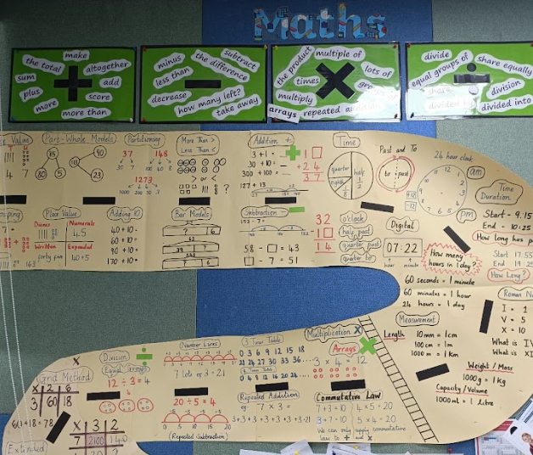
Modelling - Working Walls
Visual Learning: Working walls serve as a visual aid that supports students' understanding and learning. By displaying key information, concepts, and examples related to the current topics or subjects being taught, working walls help students make connections and reinforce their learning through visual cues.
This can be done across any subject area and is minimal preparation and effort.
Reference Point: Working walls provide a readily accessible reference point for students during their lessons. They act as a constant reminder of important information, vocabulary, and strategies, enabling students to independently access and reinforce their learning. This can enhance their confidence and sense of ownership over their education.
Scaffolding: Can provide step by step guides or frameworks. These aids help children break down complex concepts or tasks into more manageable steps.
Vocabulary development: Working walls often have key vocabulary (can also be in the children’s home language) meaning students can expand their vocabulary and develop better writing skills.
Notes:
2 column text with photo template

Slide 40
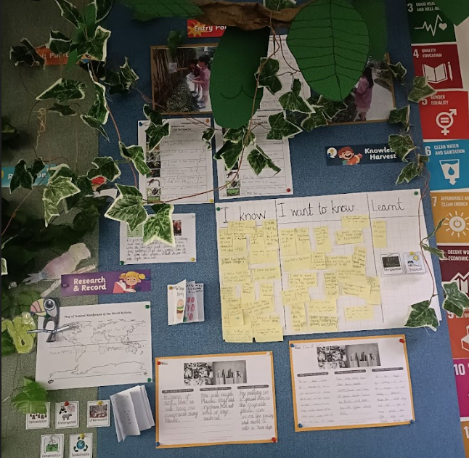
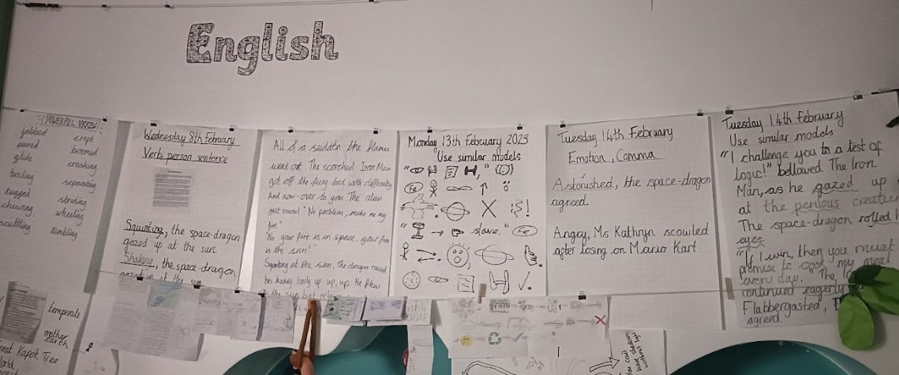
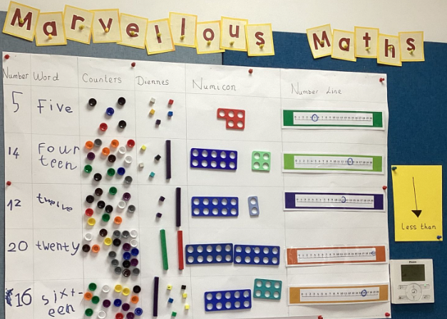
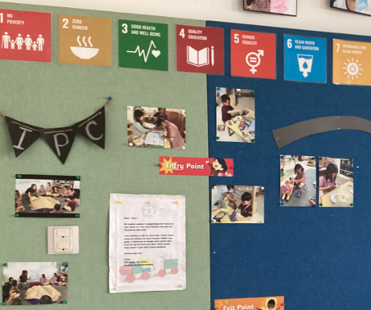
Modelling - Working Walls Examples
Notes:
2 column text with photo template

Slide 41
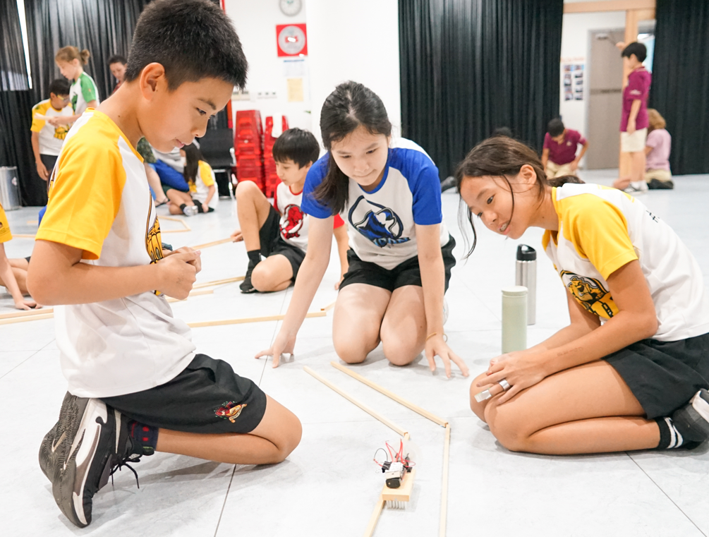
Challenges to extend learning
Using challenges to extend a student's learning is an effective way to promote student engagement, curiosity, and critical thinking skills. By providing students with challenging tasks that are just beyond their current level of understanding or ability, we can encourage them to think more deeply about the subject matter and develop their problem-solving skills.
Additionally, challenging tasks can help to foster a love of learning by providing students with an opportunity to explore new concepts and ideas in a meaningful and engaging way.
Have a challenge ready at the end of a lesson or have it available for the beginning of the next lesson.
Notes:
2 column text with photo template

Slide 42
Challenges to extend learning - benefits
Increased Engagement: Challenges provide students with exciting and stimulating tasks that grab their attention and make learning more enjoyable.
Critical Thinking Skills: By engaging in challenges, students learn to think independently and develop their own strategies for overcoming obstacles.
Higher-Level Learning: Challenges push students beyond basic knowledge acquisition and promote higher-level thinking skills. They encourage students to delve deeper into a subject, explore complex concepts, and make connections across different areas of learning.
Collaboration and Communication: Many challenges involve collaborative activities, where students work together to solve problems or accomplish a task. This fosters teamwork, communication, and cooperation among students. They learn to express their ideas, listen to others, negotiate, and share responsibilities.
Resilience and Perseverance: Challenges often present students with difficulties and setbacks. However, by overcoming these challenges, students learn the value of resilience, perseverance, and a growth mindset.
Personalised Learning: Challenges can be tailored to suit individual students' needs, allowing for personalised learning experiences. Teachers can provide different levels of difficulty or modify challenges based on students' interests and abilities.
Notes:
2 column text with photo template

Slide 43
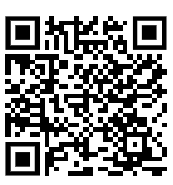
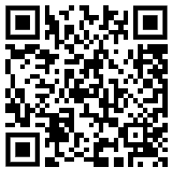
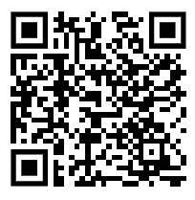
Challenges to extend learning - examples
Use the time you would normally spend ‘marking’ to make challenges for your children to complete the following day/week.
Odd one out - can be used in ANY subject
Rank in difficulty/effectiveness. (Rank the words by most effective, least effective. Bad, poor, awful, grim), or Rank the difficulty of division questions etc.
True or false? Agree or disagree? Why?
White Rose Maths - problem solving and reasoning activities
Focus Maths
I See Reasoning
Where is the Maths? QR code below - any year group can use any. Ask children WHERE they can see Maths in the picture. Let them decide by themselves or give them an objective from Complete Maths and ask them to find the specific Maths in the picture. For example, can you see any lines of symmetry? Can you make any fact families?
Vocab Lab App - can you up-level any words?
Focus Maths
I See Reasoning
Where is the Maths?
Notes:
2 column text with photo template

Slide 44
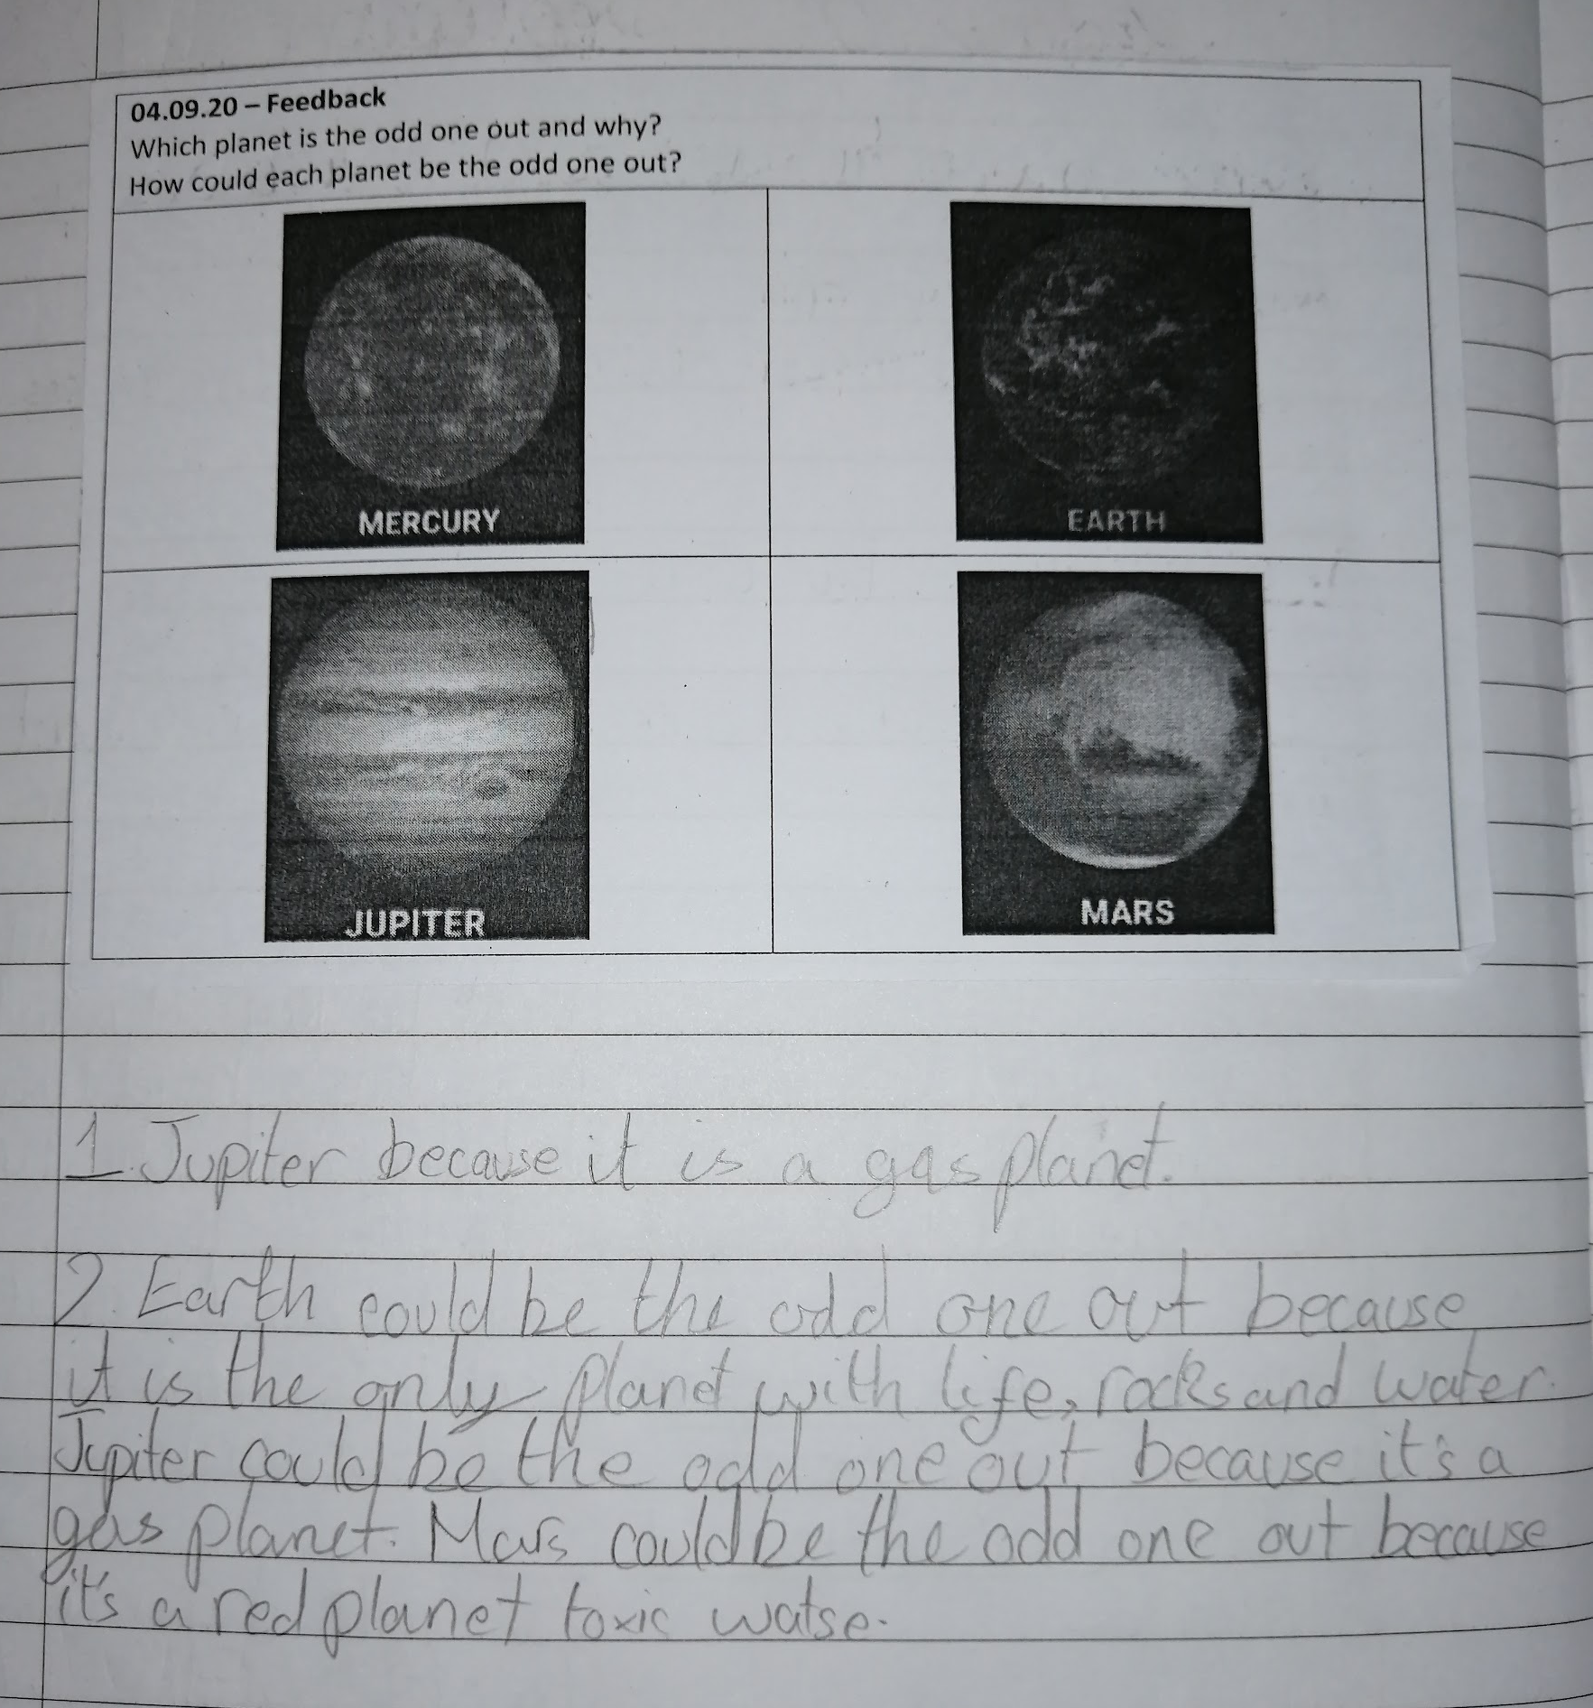
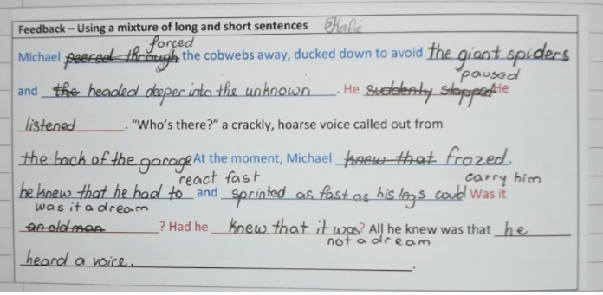
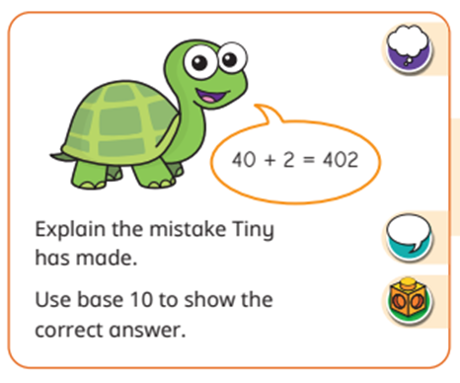
Challenges to extend learning - examples
Notes:
2 column text with photo template

Slide 45
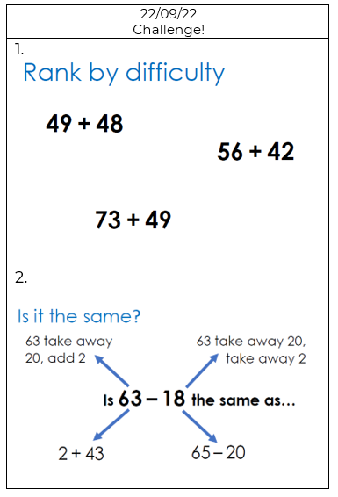
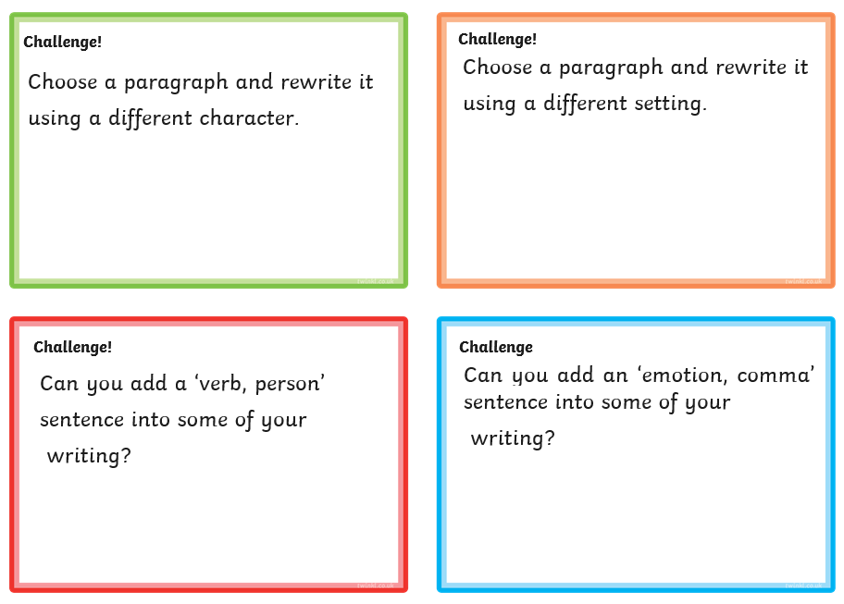
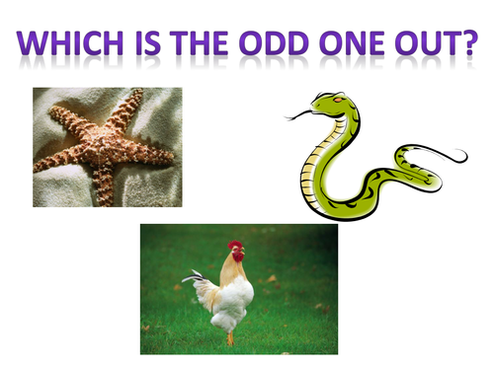
Challenges to extend learning - examples
Notes:
2 column text with photo template

Slide 46
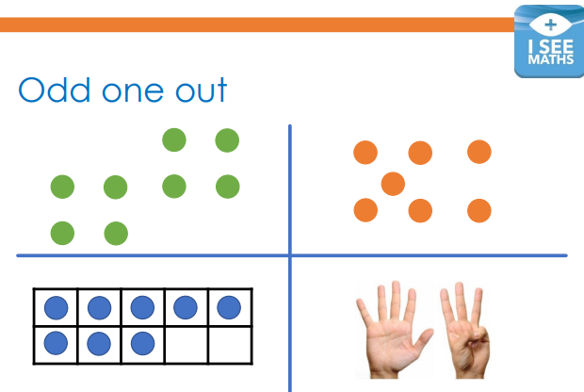
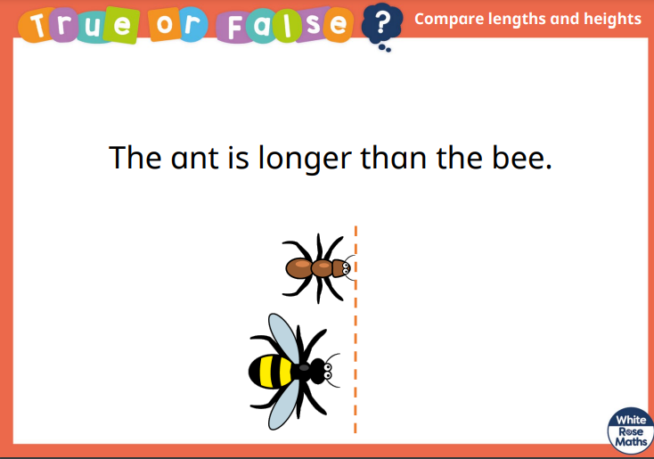
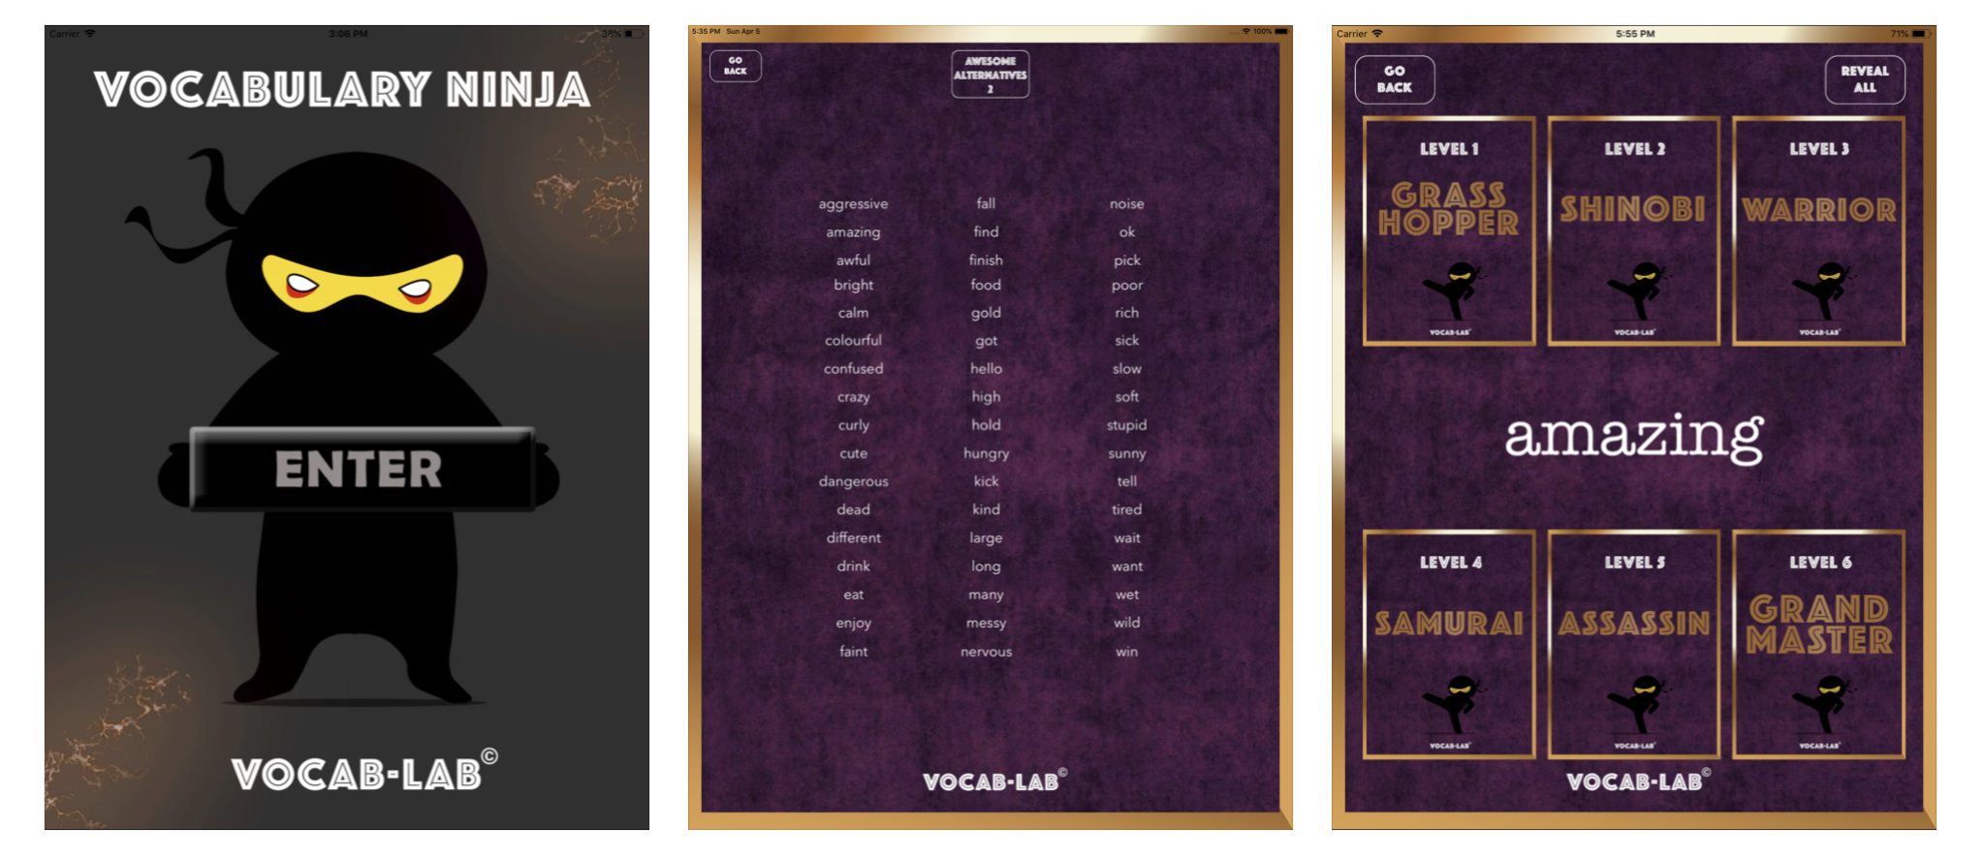
Challenges to extend learning - examples
Notes:
2 column text with photo template

Slide 47

Self Assessment
Students take responsibility for evaluating their own progress and learning. It involves encouraging students to reflect on their own work, identify their strengths and weaknesses, and set goals for future learning.
It allows students to take ownership of their learning and to develop important skills such as critical thinking, self-reflection, and goal-setting.
Notes:
2 column text with photo template

Slide 48
Self Assessment - benefits
Encourages ownership of learning: When students are given the opportunity to evaluate their own work, they are more likely to be motivated and engaged in the learning process.
Develops critical thinking skills: Self-assessment requires students to analyse their own work and evaluate its strengths and weaknesses.
Provides immediate feedback: When students can identify areas where they need to improve, they can take action to address those areas right away.
Increases self-awareness: By reflecting on their own learning, students can gain a better understanding of their own strengths and weaknesses, and this can help them to set goals for improvement.
Fosters a growth mindset: When students see that they can improve through self-reflection and hard work, they are more likely to embrace challenges and persevere through difficult tasks.
Notes:
2 column text with photo template

Slide 49

Self Assessment - When to use
When to use -
Mini plenaries throughout the lesson.
If you have noticed a common misconception.
At the end of a ‘hot task’?
A reasoning maths question.
An open ended science/IPC question.
If a student needs challenging to extend learning.
Add child working photo here
Notes:
2 column text with photo template

Slide 50
Self Assessment - How to use
Provide clear expectations - before asking students to assess their own work, it's important to provide them with clear expectations and criteria for evaluation. Make sure that students understand what they are being asked to evaluate, and provide them with specific guidelines.
Model self-assessment: This can help students to understand what self-assessment looks like and how it can be used to improve learning.
Provide time for reflection: This can help them to identify areas where they need to improve and to think critically about their own learning.
Provide feedback: If you notice that students are consistently identifying the same areas for improvement, for example, you might provide targeted instruction in those areas.a
Notes:
2 column text with photo template

Slide 51

Self Assessment - Examples to try
Spot your mistakes. Look for areas where easily definable improvements could be made or where there are clear mistakes. Identify a few clear areas that are important to your success criteria. Don’t ‘nitpick’
Write a reflection of your learning - can you summarise your learning in ‘..... words’ or ‘pictures’
Self-marking - have an answer sheet ready and available for children to self-assess. Set clear expectations so that they know not to just copy the correct answers.
Rubrics: Give students a rubric to use when evaluating their own work. This can help students to understand what is expected of them and to evaluate their work more objectively. Students can also use the rubric to set goals for improvement.
Notes:
2 column text with photo template

Slide 52
Self Assessment - Examples to try
Exit slips: Use exit slips at the end of a lesson or unit to ask students to reflect on what they learned. For example, you might ask students to write down one thing they learned, one question they still have, and one connection they made. This can help students to reflect on their learning and identify areas where they need further support.
Self-checklists: Provide students with a checklist of skills or concepts to check off as they master them. This can help students to track their own progress and identify areas where they need to focus their efforts.
Traffic lights - Green: I am now ready to teach someone else. Yellow: Objectives partially met. Red: The student believes they have not learned what was intended. Change the mindset.
Red or Greed Disks: CD sized with red on one side and green on the other. If the teacher is going too fast, they turn the disk to red.
Orange box - draw around a part of children’s work that needs improvement. Children to independently or in pairs improve this part.
Notes:
2 column text with photo template

Slide 53
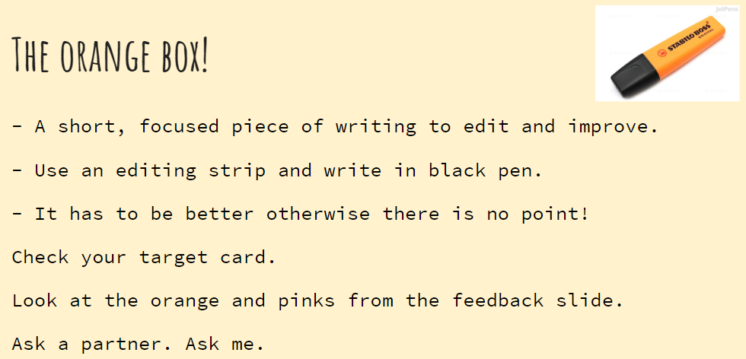
Self Assessment - Examples to try
Notes:
2 column text with photo template

Slide 54
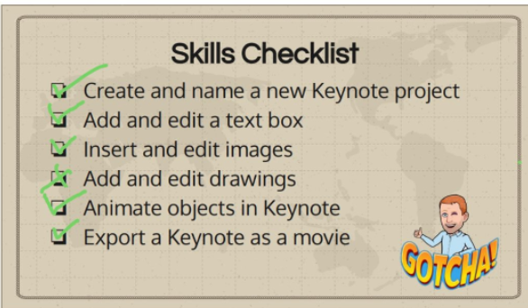
Self Assessment - Examples to try
Notes:
2 column text with photo template

Slide 55
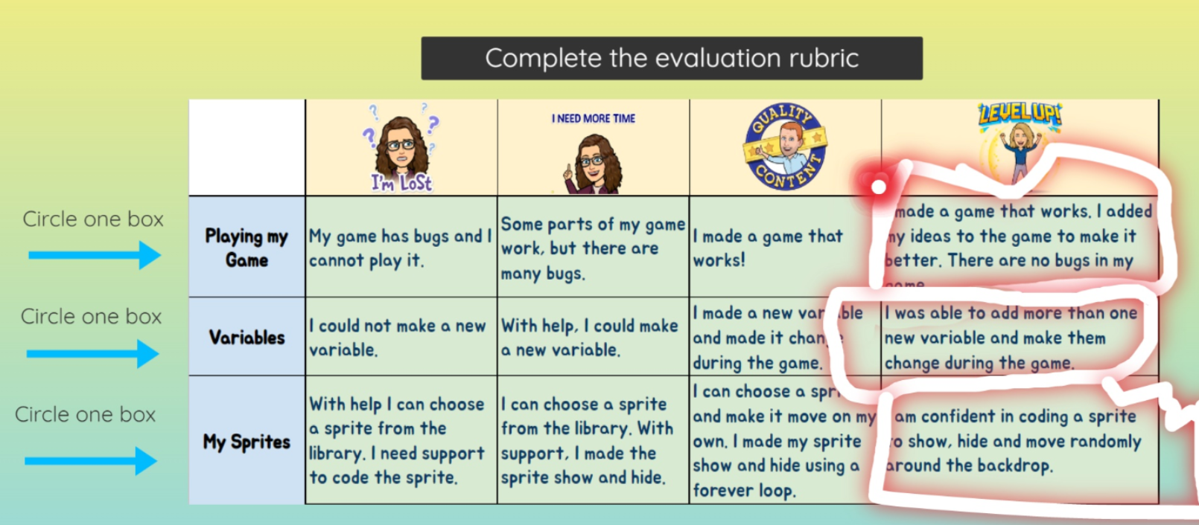
Self Assessment - Examples to try
Notes:
2 column text with photo template

Slide 56
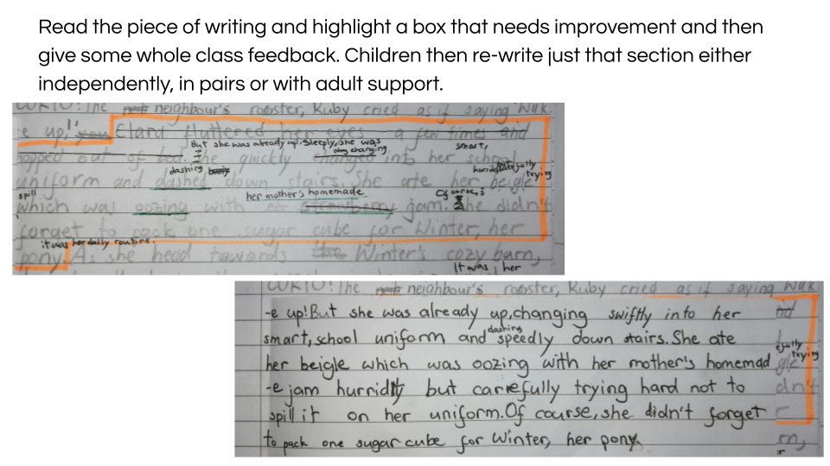
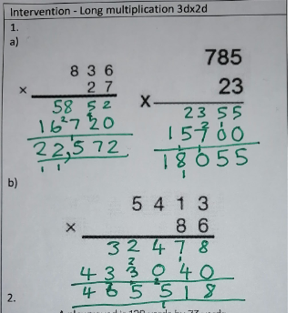
Self Assessment - Examples
Notes:
2 column text with photo template

Slide 57
Self Assessment - Editing Stations
Designated areas or activities within the classroom where students engage in the process of editing and revising their written work.
This can be done during a single English lesson at the end of a unit, with the different stations relating to the different areas of the success criteria just taught or can be an area in which the teacher believes needs improvement as a whole.
Have a guidance sheet on each table and put a timer on (7 minutes is normally a good amount of time). Children read through the guidance sheet and check their piece of work for the specific success criteria and edit and improve their work as necessary. At the end of the 7 minutes, children stand up and move to the next table, with a different guidance sheet there to help them.
Teacher and TA sit on one station each and by the end of the lesson, will have worked with every student in the class helping and prompting them to improve their work.
Children should have an edited piece of work at the end of the lesson with minimal ‘planning’ and no ‘marking’ from the teacher.
Notes:
2 column text with photo template

Slide 58
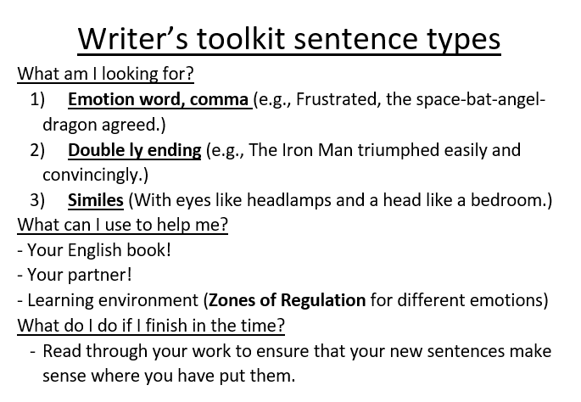
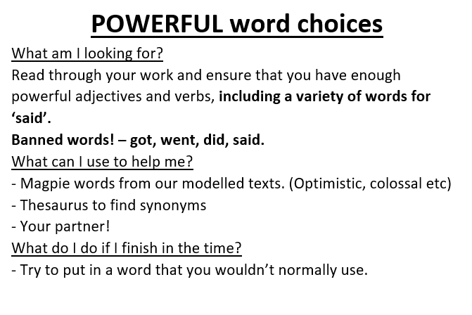
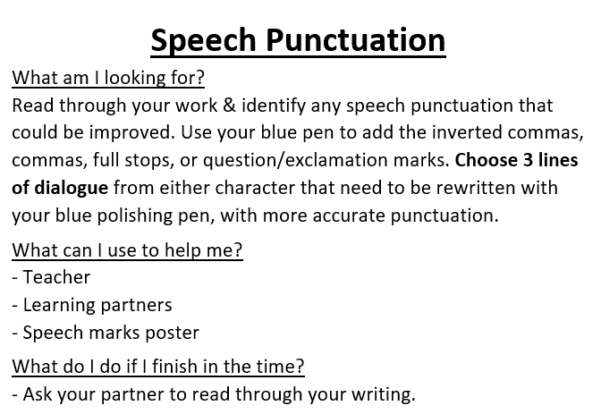

Self Assessment - Editing Stations
Notes:
2 column text with photo template

Slide 59

Questioning
Michael Chiles -
Questioning strategy 1 - the extender. Tell me more….
Ask questions that encourage pupils to develop their response.
Can you give me an example?
What do you mean?
Can you develop this further?
Expand on this by…
Why did you choose this?
What evidence supports your point?
Using these types of questions can develop a deeper understanding of pupil knowledge by elaborating on what they have learnt and develop further connections to previous learning in their long-term memory.
Notes:
2 column text with photo template

Slide 60

Questioning
Questioning strategy 2 - the unveiling: Tell me something…
Not accepting the ‘I don’t know’ response will mean you can gather feedback to check their understanding. Building a receptive culture where children feel comfortable to contribute in front of their peers without the fear of retribution is important. It will take time to not accept the ‘I don’t know’ response but it is worth it.
Notes:
2 column text with photo template

Slide 61

Questioning
Questioning strategy 3 - the chain: build on it…
Use questioning to build on a specific concept by involving several pupils. “Can you build on that answer?”
A - agree
B - build on
C - challenge .
Notes:
2 column text with photo template

Slide 62

Peer Assessment
Peer-assessment involves students assessing the work of their peers.
It promotes active learning, critical thinking, and self-reflection among students, while also developing their communication and evaluation skills. Peer-assessment can be a powerful tool for fostering a collaborative and supportive classroom environment. This encourages students to take ownership of their learning and to become actively engaged in the evaluation process.
By involving students in assessing each other's work, they gain a deeper understanding of the criteria and standards that define quality work in various subjects.
Notes:
2 column text with photo template

Slide 63

Peer Assessment
Effective Cooperative Learning (Dylan Wiliams)
4 main factors:
Motivation - Students help their peers learn because, in well-structured cooperative learning settings, it is in their own interest to do so, and effort increases.
Social cohesion - Students help their peers because they care about the group, again leading to increased effort.
Personalisation - Students learn more because their more able peers can engage with the particular difficulties a student is having.
Cognitive elaboration - Students who provide help in group settings have to think through the ideas more clearly.
Notes:
2 column text with photo template

Slide 64
Peer Assessment - things to consider
Clear Guidelines: Provide students with clear guidelines and criteria for assessment. Break down the assessment criteria into simple language that children can understand. This helps them focus on specific aspects of their peers' work and provide constructive feedback.
Training and Modeling: Dedicate time to train students on how to provide effective feedback. Model the process by demonstrating examples of constructive feedback and emphasising the importance of being respectful and supportive.
Rubrics and Checklists: Utilise rubrics or checklists that outline the criteria for assessment. These tools help students stay focused and provide a structured framework for evaluating their peers' work.
Peer Feedback Sessions: Organise peer feedback sessions where students have the opportunity to assess and discuss each other's work. Encourage them to provide both positive feedback and suggestions for improvement. This can be done at any part of the lesson.
Reflection and Revision: Encourage students to reflect on the feedback they receive from their peers and make changes accordingly. This fosters a growth mindset and emphasises the idea that feedback is a valuable part of the learning process.
Teacher Facilitation: It is important for the teacher to provide guidance and support throughout the process. The teacher can monitor the feedback sessions, offer clarification when needed, and ensure that the assessment is fair and consistent.
Notes:
2 column text with photo template

Slide 65
Peer Assessment
Benefits of Peer-Assessment:
Active Engagement: Peer-assessment actively involves students in the learning process, encouraging them to think critically and reflect on their own work as well as their peers'.
Improved Learning Outcomes: By assessing their peers' work, students gain a deeper understanding of the subject matter and the assessment criteria. They develop a clearer sense of what constitutes quality work, which can lead to improved learning outcomes.
Constructive Feedback Skills: Peer-assessment helps students develop their ability to provide constructive feedback and learn from others' perspectives. This fosters communication skills, empathy, and respect for diverse viewpoints.
Increased Self-Reflection: Engaging in peer-assessment prompts students to reflect on their own work and identify areas for improvement. They become more self-aware and take greater responsibility for their learning.
Collaborative Environment: Peer-assessment promotes a collaborative classroom environment, where students support and learn from each other.
The children are speaking in their own way, which will help other children to understand more than the ‘weird language’ (Dylan Wiliams) that the teacher uses.
Notes:
2 column text with photo template

Slide 66
Peer Assessment - Examples Dylan Williams
C3B4ME - students must seek assistance from at least three other students before seeking it from the teacher. “There is more than one teacher in the room.” This could be in conjunction with a ‘no hands’ technique. Before a response is made, the child could brainstorm ideas with at least three other children before answering.
Peer improvements without given success criteria - have children feedback on other children’s work by keeping them unaware of the success criteria for that particular piece of work. Sometimes it could be adjectives, capital letters etc.
Help board - students take ownership of their ‘struggles’ by writing questions on their student help board for other children to answer throughout the day. Neil Gorton- can’t think of a good example here.
Two Stars and a Wish - effective way of getting started with peer-assessment. Two things the student thinks were good about their partner’s work and a suggestion for improvement. This could be done on sticky notes, in books, verbally, on Seesaw comments. Have other children comment on how helpful the feedback was to improve the quality of the children’s comments.
Questions - instead of saying ‘any questions’ say ‘in your groups, decide if you have any questions.’ Giving the children a chance to talk it through will give children more confidence to ask in front of the whole class. It can also stop questions such as ‘Do we write the date?’ and questions already answered.
Notes:
2 column text with photo template

Slide 67
Peer Assessment - Examples Dylan Williams
Error classification - teachers may classify errors such as spellings, tense and direct speech punctuation and underline the examples in the children’s work. Children need to identify the errors and find someone in the classroom that has different mistakes, working together to help each other correct their work.
Student reporter - have a student lead the end-of-lesson discussion. The teacher finishes their lesson 10 minutes early or uses their plenary time and the student reporter summarises the lesson’s main points and answers any remaining questions that the children might have.
Preflight checklist - using the success criteria at the end of a unit of work, partners must ‘sign off’ on the piece of work by checking that all parts of the success criteria have been completed to a good standard. For example, in Science, a prediction, results, method etc.
I-You-We Checklist - at the end of a group activity, each student records something about their contribution, their partner’s contributions and their whole group’s contributions. When the students know this might happen, they are more likely to be honest and accurate about their own contributions
.
Reporter at Random - choosing children at random to report back after a group activity increases their accountability as they know they might have to report back. More importantly, children who want their group to do well will ensure that the other children in the group are paying attention.
If you’ve learned it, help someone who hasn’t - if able students engage in peer ‘tutoring’ both students will benefit. When students teach their peers, they reinforce their own understanding of the subject matter. Explaining concepts and answering questions can deepen their knowledge and make them more proficient in the topic.
Notes:
2 column text with photo template

Slide 68

T.
Peer Assessment - TAG Feedback
Tell me what you enjoyed
"I like how you opened with a question."
A.
Ask a question
"Have you considered adding sources?"
G.
Give a Suggestion
"I wonder what would happen if you flipped paragraphs 2 and 3 around?"

Slide 69
Tell me something you enjoyed…
''I like how you…"
"I was interested when you said/did…"
"My favorite part was…"
"Great job on…"
"What really impressed me was…"
"The best part of this to me was…"
"It really had a big impact on me when…"
Notes:
Explain that this will be the template students will use going forward for giving feedback.

Slide 70
Ask a question…
"Why did you…?"
"How did you…?"
"What happened when…?
"Why didn't you…?"
"Why do…?"
"Should you…?"
"Have you considered______?"
Notes:
Explain that this will be the template students will use going forward for giving feedback.

Slide 71
Give a suggestion…
"I need to hear more about…"
"Next time you could try…"
"I liked ___ but I don't understand ____."
"Instead of ____, you could try______."
"I wonder what would happen if…"
"You could try…"
"You could add…"
Notes:
Explain that this will be the template students will use going forward for giving feedback.

Slide 72



Alan Peat Sentence Types
These sentence types were developed by Alan Peat and can be used to enhance writing skills and to teach explicit grammar.
Similar to the I do, We do, You do method, model a specific sentence type that relates to your model text. Create your own, a class one and then children to create their own individual sentence to be used in their piece of independent writing. These can be stored in Magpie Books/Electronic Magpie journals for use in future pieces of work.
Notes:
2 column text with photo template

Slide 73

Alan Peat Sentence Types - Y2 example
Notes:
2 column text with photo template

Slide 74

Alan Peat Sentence Types - Y3 example
Notes:
2 column text with photo template

Slide 75

Alan Peat Sentence Types - Y4 example
Notes:
2 column text with photo template

Slide 76

Alan Peat Sentence Types - Y5/6 example
Notes:
2 column text with photo template

Slide 77

Word of the Day
Vocabulary Ninja provides various tools, resources, and strategies to enhance vocabulary acquisition, particularly in the context of literacy and language learning.
Vocabulary Ninja offers a wide range of resources, including word mats, vocabulary challenges, reading comprehension activities, and vocabulary games. The website provides access to word lists, vocabulary cards, and other materials that can be used in classrooms or for self-study.
Vocabulary Ninja encourages the use of challenging words and provides strategies to improve vocabulary acquisition through activities, word of the day features, and targeted resources.
Can be used for Y1-Y6 🙂
How and when to use -
English Starter or Plenary
5 minute time filler
Have the children copy the word and meaning into their books. You can use the specific word of the day or find one from before that relates to your topic. If they use it in their writing, have them underline it in a universal colour so you can identify the use of it correctly.
Notes:
2 column text with photo template

Slide 78


Word of the Day
Notes:
2 column text with photo template

Slide 79

Feedback in EYFS
In EYFS, we value children's interest and prioritise providing quality interaction through play and quality conversations. We provide in-the-moment responsive feedback by extending play through high quality questioning and meaningful conversations. We provide a language rich environment that provide the key vocabulary and opportunities for the children to enhance their learning.
Through our learning journey recorded on Seesaw, we are able to document children's activities and note down significant interests and ideas that contribute to building our unique and child-centred curriculum.
Notes:
2 column text with photo template

Slide 80


Feedback in EYFS
Through our regular observations we are able to celebrate the children’s achievements, record their development and showcase the journey of a child’s learning through carefully documented
Observations
Pieces of mark-making, writing or artwork
Snapshots of progress made
Direct quotes from the child
Comments from the parents/carers as well as their teachers
Occasional notes of children’s next steps to learning as a way to provide feedback
The entries into our Seesaw Learning Journey will be dated and linked to the appropriate area of learning in the EYFS and Characteristics of Effective Learning in order to indicate a child’s progress in their learning and development. In BIS, we are encouraged to post at least 3 observations per child per week to be able to record enough evidence to support our assessment. TAs and teachers in the year group are also encouraged to contribute to each child’s learning journey where possible.
Notes:
2 column text with photo template

Slide 81

F1
Feedback examples through Seesaw Observations:
Notes:
2 column text with photo template

Slide 82

F2
Feedback examples through Seesaw Observations:
Notes:
2 column text with photo template

Slide 83

F3
Feedback examples through Seesaw Observations:
Notes:
2 column text with photo template

Slide 84


F1 and F2
Draw a Person Feedback Examples:
Notes:
2 column text with photo template

Slide 85

F3
Phonics Book Feedback Examples:
Notes:
2 column text with photo template

Slide 86

F3
Feedback examples through Seesaw Observations:
Notes:
2 column text with photo template

Slide 87

Parents as Partners:
We believe in the importance of parents as key partners in children’s learning, and we therefore maintain open communication with parents, sharing feedback and insights regularly either in person or through email. We encourage parents to read, share books, to play with their child, and to talk with them at home and outside school about their daily life and regular routines.
Notes:
2 column text with photo template

Slide 88

EYFS Verbal Feedback from Teachers:
As responsive teachers, we value the use of immediate positive as well as constructive verbal feedback, particularly with the youngest group of children in our school. This is always given using clear and concise language appropriate to the age of the child. Consider the tone of voice you use, your body language, how you can encourage the child to respond and join in with the session.
Use verbal feedback to recognise effort as well as the level of achievement. Use it to also discuss what they can work on next and how it could be better. Include questions to extend learning and allow the child to elaborate on their ideas.
For behavioural feedback, we use the language of 'good and poor choices’ as well as using the BIS Care Kits.
Where appropriate staff will make a note of the conversation that they have had with the children and document them on Seesaw.
Notes:
2 column text with photo template

